Slide 1
ClickOS and the Art of Network Function Virtualization
Presenter : Yin Hao

Slide 2
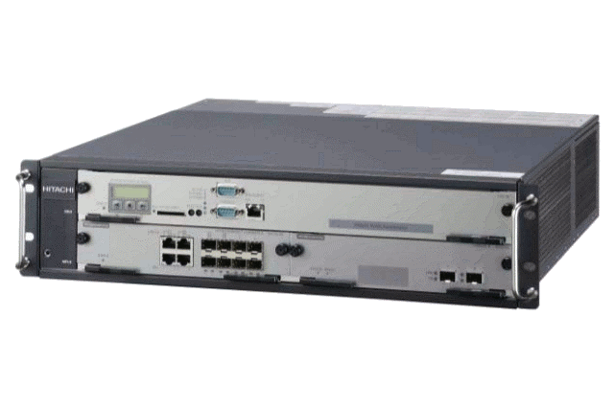
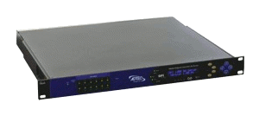
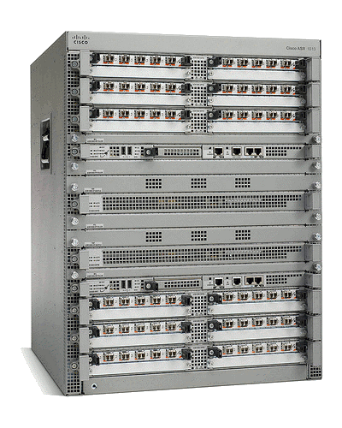
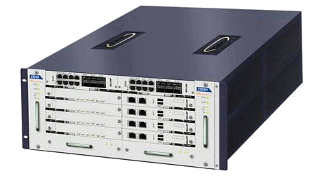
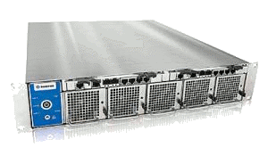
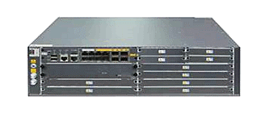
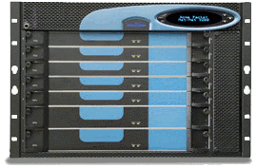
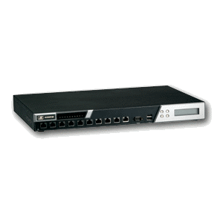
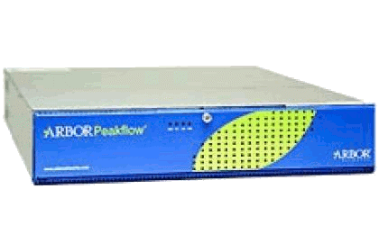
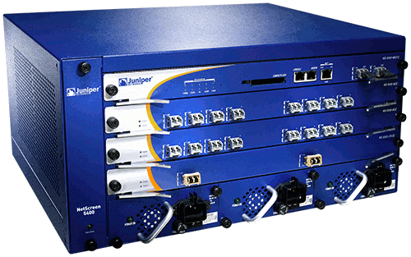
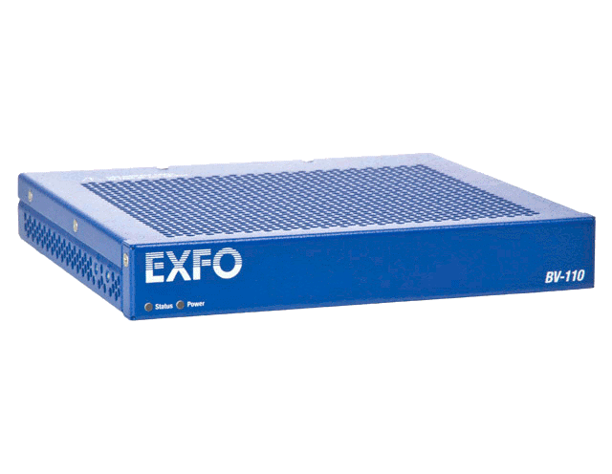
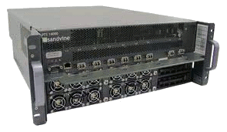
A Middlebox World
ad insertion
WAN accelerator
BRAS
transcoder
session border controller
IDS
carrier-grade NAT
load balancer
DDoS protection
firewall
DPI
QoE monitor

Slide 3
Hardware Middleboxes - Drawbacks
Expensive equipment/power costs
Difficult to add new features (vendor lock-in)
Difficult to manage
Cannot be scaled on demand (peak planning)

Slide 4
Shifting Middlebox Processing to Software
Can share the same hardware across multiple users/tenants
Reduced equipment/power costs through consolidation
Safe to try new features on a operational network/platform
But can it be built using commodity hardware while still achieving high performance?
ClickOS: tiny Xen-based virtual machine that runs Click

Slide 5

Requirements for Software Middlebox
ClickOS
Fast Instantiation
Small footprint
Isolation
Flexibility
Performance
30 msec boot times
5MB when running
Provided by Xen
Provided by Click
10Gb/s line rate 45 μsec delay per packet

Slide 6
What’s ClickOS ?
domU
ClickOS
apps
Click
guest OS
mini OS
paravirt
paravirt
Work consisted of:
Build system to create ClickOS images (5 MB in size)
Emulating a Click control plane over MiniOS/Xen
Reducing boot times (roughly 30 milliseconds)
Optimizations to the data plane (10 Gb/s for almost all pkt sizes)
Implementation of a wide range of middleboxes

Slide 7
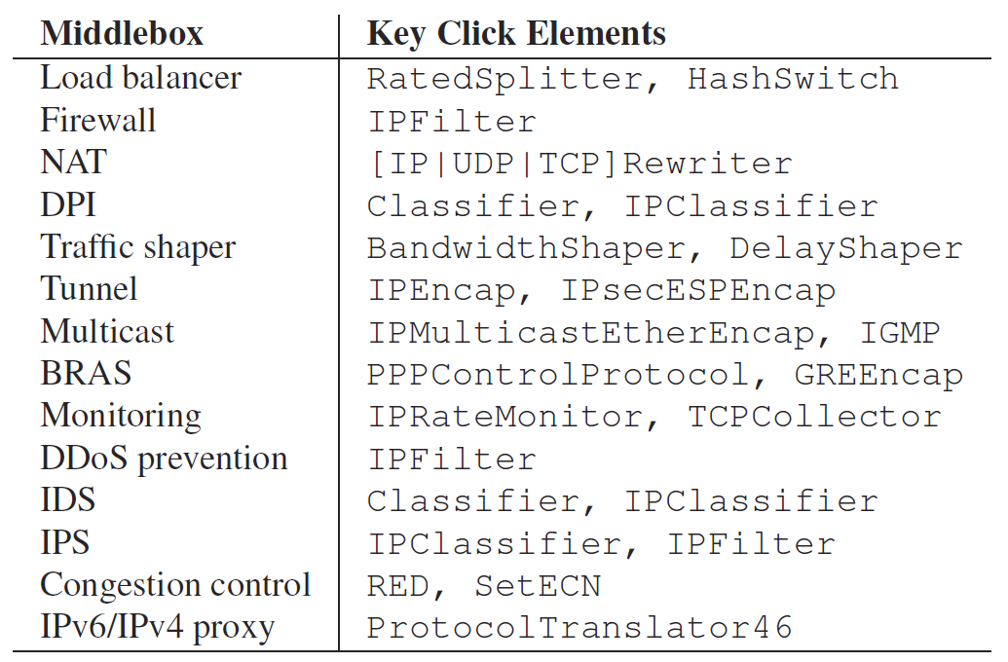
Programming Abstraction for MBox
Building MBox using Click
→ We can use 300+ stock Click elements!

Slide 8
ClickOS
domU
Click
guest OS
paravirt
Click middlebox inside Linux VM
(+) Can achieve domain isolation
(-) Memory-hungry (128MB or more)
(-) Large boot time (5 seconds to boot)

Slide 9
ClickOS
domU
ClickOS
Click
Click
guest OS
mini OS
paravirt
paravirt
Why we use MiniOS?
Single address space (= no kernel/user separation)
Completely eliminates system call costs
Runs a single application per VM
Runs on single-core only (enough for 10Gbps packet processing)
Cooperative scheduler
Reduces context switch overhead
Small footprint and minimal boot time

Slide 10
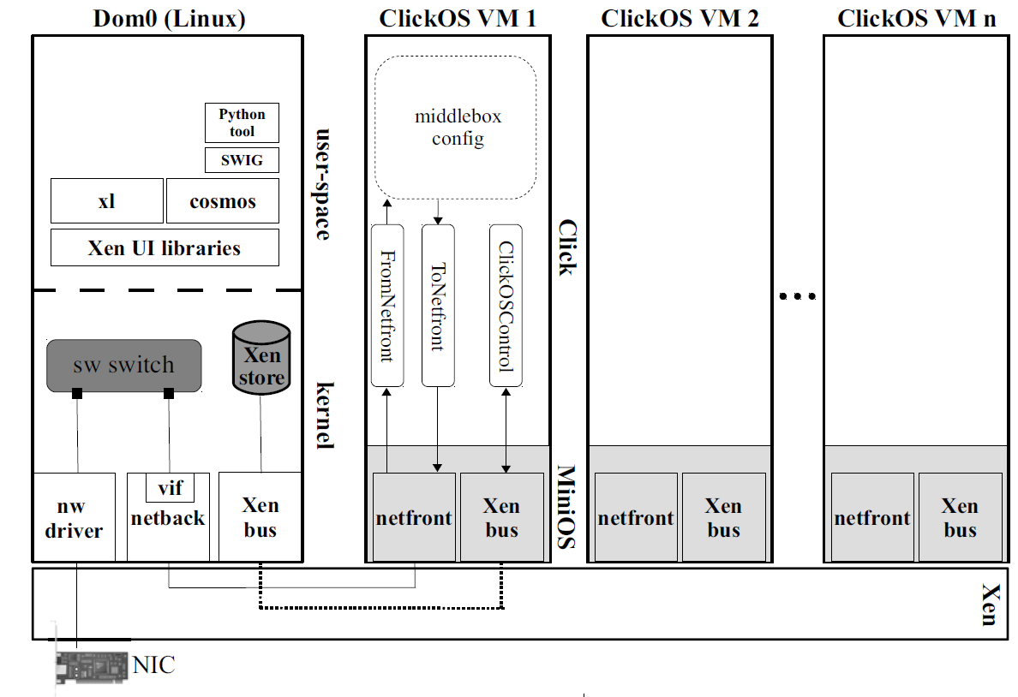
ClickOS Architecture
Console
Xen store = communication path (Dom0 - VM)
Allows the users to install Click configs in ClickOS VM
Set and retrieve state in elements (e.g. packet counter)

Slide 11
ClickOS Boot Time
(optimized)
Re-designed the MiniOS toolchain for faster boot.
Tasks | Time spent
Issue and carry out the hypercall to create the VM | 5.2 ms
Build and boot VM image | 9.0 ms
Set up Xen store | 2.2 ms
Create the console | 4.4 ms
Attach VM to back-end switch | 1.4 ms
Install the Click configuration | 6.6 ms
Total | 28.8 ms
(added)
Provide a console through which Click configurations can be controlled

Slide 12
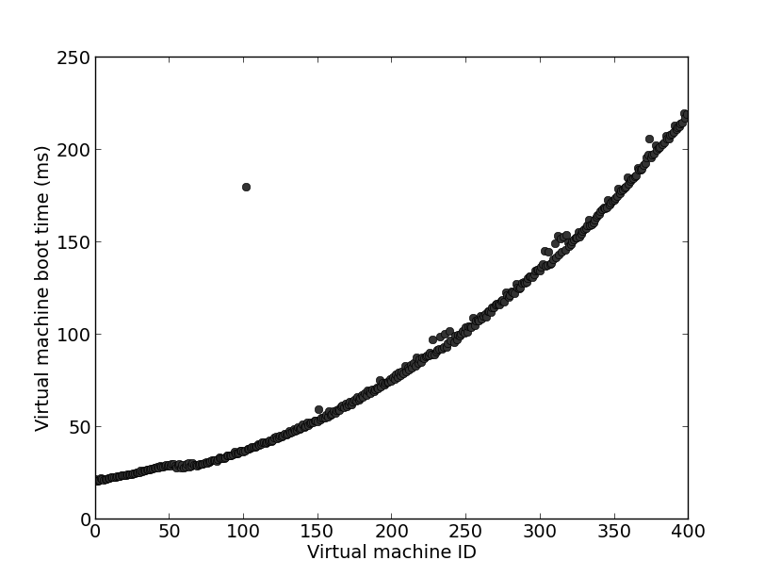
Booting Large Number of ClickOS VMs
contention on the Xen store
220 msec
30 msec

Slide 13
ClickOS Memory Footprint
 | Usage
Basic memory footprint of a ClickOS image | 5 MB
Netmap packet ring buffers (e.g. 2048-slot ring) | 8 MB
Middlebox application states (e.g. 1000 rules for IP router and firewall + 400 rules for IDS) | 137 KB
Total | < 14 MB
(optimized)
Includes 200+ supported Click elements and minimal set of libraries

Slide 14
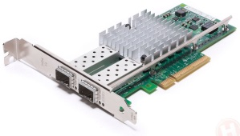
Performance Analysis
Packet size (bytes) | 10 Gbit/s rate
64 | 14.88 Mpps
128 | 8.4 Mpps
256 | 4.5 Mpps
512 | 2.3 Mpps
1024 | 1.2 Mpps
1500 | 810 Kpps
netback
netfront
Click
native driver
OVS
Xen bus/store
vif
Event channel
FromDevice
ToDevice
Xen ring API (data)
(maximum sized packets)
300 Kpps
350 Kpps
225 Kpps

Slide 15
Performance Analysis
Driver domain (Dom 0)
ClickOS domain
native driver
netback
Xen bus/store
netfront
Click
OVS
vif
Event channel
FromDevice
ToDevice
Xen ring API (data)
~ 3.4 us (3)
~ 600 ns (2)
772 ns (1)
Copying packets between guests greatly affects packet I/O (1)
Packet metadata allocations (2)
Backend switch is slow (3)
Mini netfront not as good as Linux

Slide 16
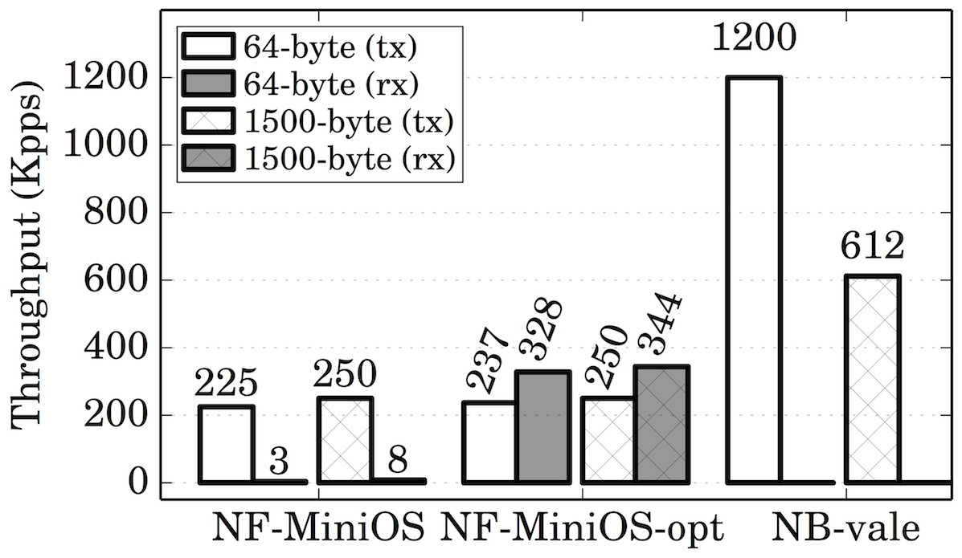
Optimizing Network I/O
Driver domain (Dom 0)
ClickOS domain
netmap driver
netback
Xen bus/store
netfront
Click
VALE
port
Event channel
FromDevice
ToDevice
Xen ring API (data)
NF(netfront)-MiniOS-opt
Reuse memory grants
Now uses polling for Rx
NB-vale
Introduce VALE as the backend switch
Netmap-supported software switch for VMs (Luigi Rizzo, CoNEXT 2012)
Increase I/O requests batch size

Slide 17
Optimizing Network I/O
Driver domain (Dom 0)
ClickOS domain
netmap driver
netback
Xen bus/store
netfront
Click
VALE
Event channel
FromDevice
ToDevice
Directly mapped packet buffers
Optimized Xen network I/O pipe
netback : no longer involved with packet transfer
netfront : use netmap API for better performance
To map the packet buffers into its space directly
More optimizations: asynchronous transmit, grant re-use
Optimized VALE
Static MAC address-to-port mapping (instead of learning bridge)

Slide 18
ClickOS Prototype Overview
Click changes are minimal (~ 600 LoC)
New toolstack for fast boot times
Cross compile toolchain for MiniOS-based apps
netback changes comprise ~ 500 LoC
netfront changes comprise ~ 600 LoC
We have implemented netfront driver for both MiniOS and Linux

Slide 19
Evaluation

Slide 20
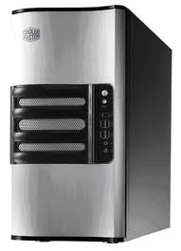
ClickOS Base TX Performance
ClickOS
Measurement Box
10Gb/s direct cable
Intel Xeon E1220 4-core 3.2GHz (Sandy bridge)
16GB RAM, 1x Intel x520 10Gbps NIC
One CPU core assigned to VMs, the test to the Domain-0
Linux 3.6.10

Slide 21
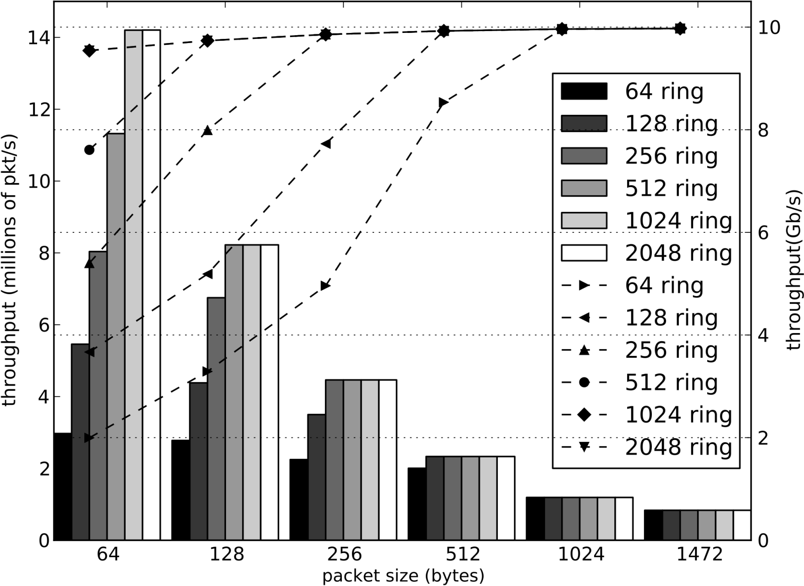
ClickOS Base TX Performance

Slide 22
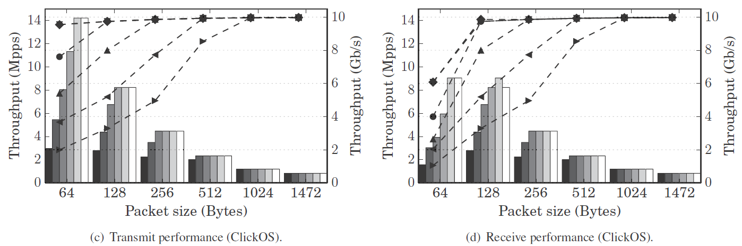
ClickOS Tx vs. Rx Performance

Slide 23
ClickOS (virtualized) Middlebox Performance
10Gb/s direct cable
10Gb/s direct cable
Host 1
ClickOS
Host 2
Intel Xeon E1220 4-core 3.2GHz (Sandy bridge)
16GB RAM, 1x Intel x520 10Gbps NIC
One CPU core assigned to VMs, 3 CPU cores for Domain-0
Linux 3.6.10

Slide 24
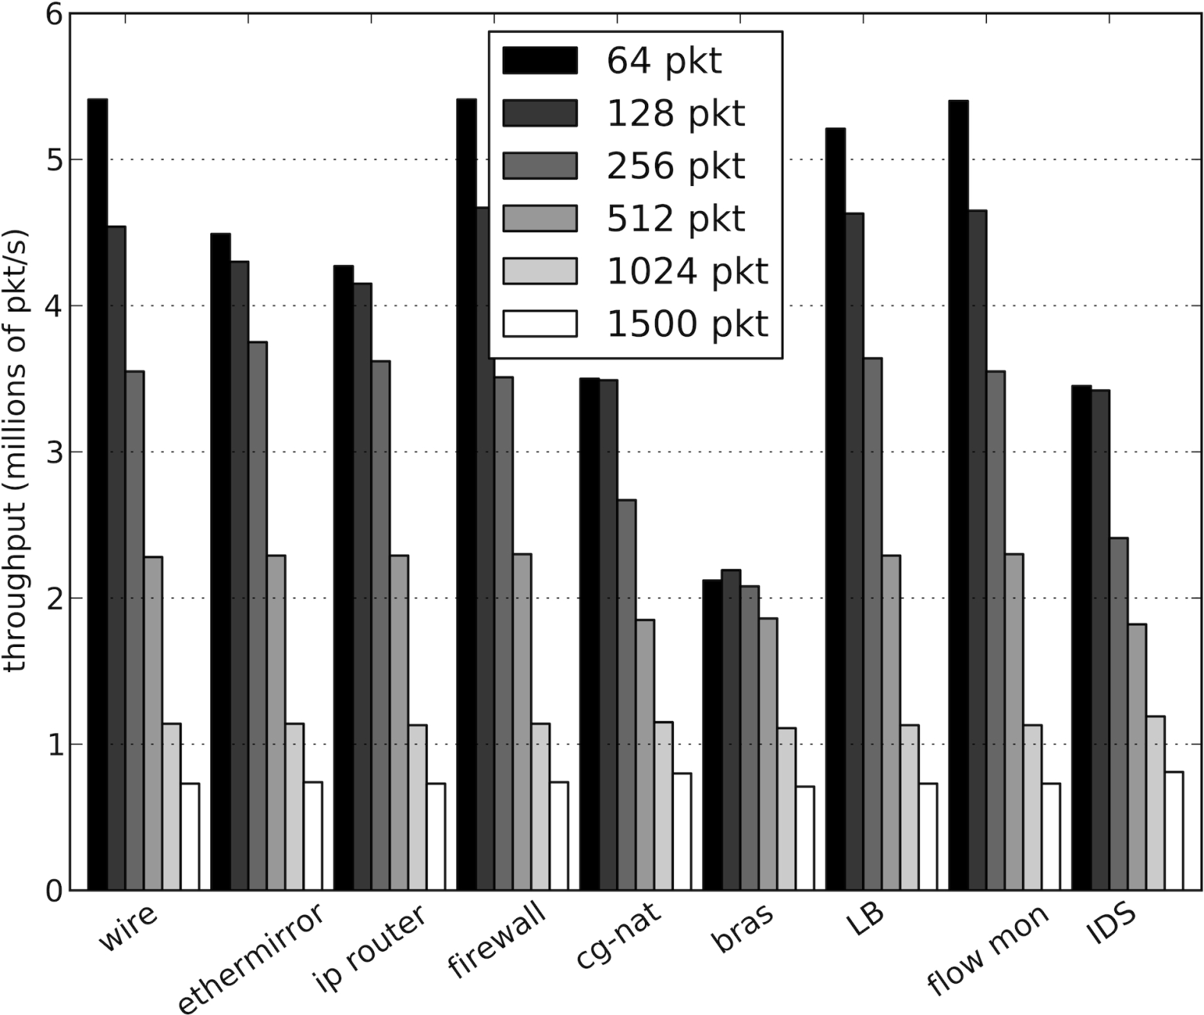
ClickOS (virtualized) Middlebox Performance
Line rate for 512B pkts

Slide 25
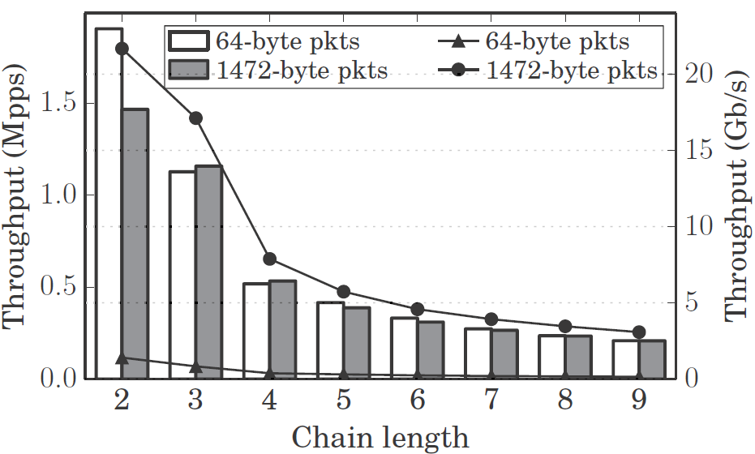
Chaining ClickOS VMs (back-to-back)
1 CPU core for running all the VMs

Slide 26
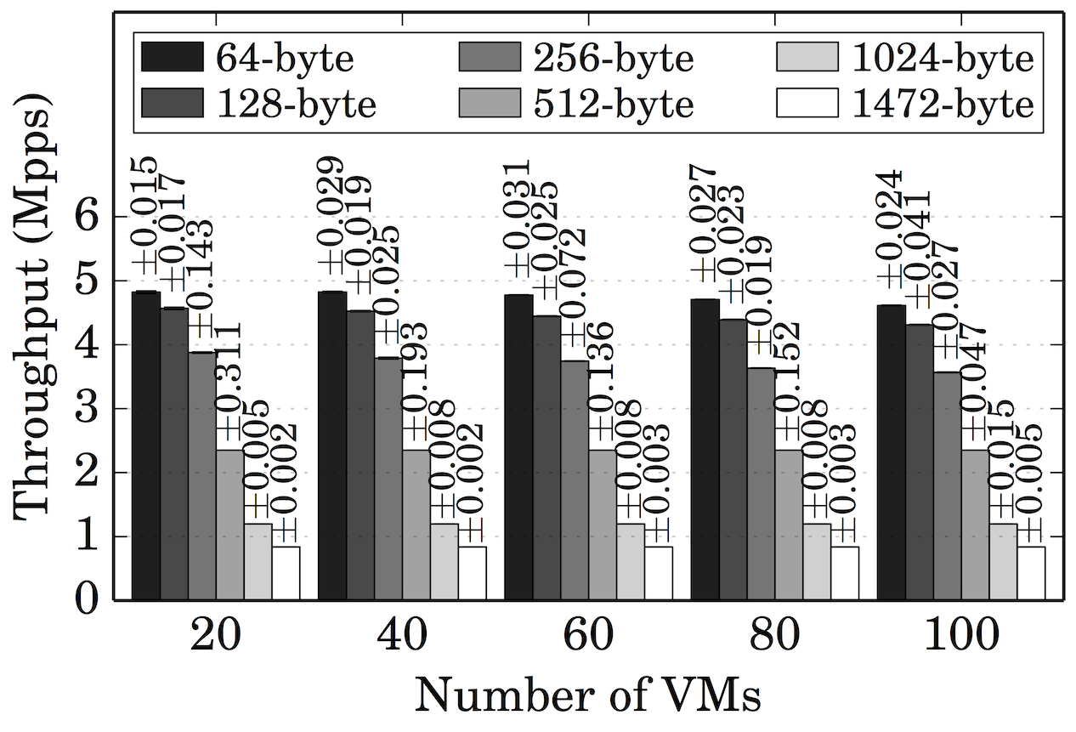
Scaling out – 100VMs Aggregate Throughput
1 CPU core for running all the VMs (Tx only)

Slide 27
Conclusions
Virtual machines can do flexible high speed networking
ClickOS: Tailor-made operating system for network processing
Small is better: Low footprint is the key to heavy consolidation
Memory footprint: 5MB
Boot time: 30 ms

Slide 28

Thank You! Q&A

